Slide 1


Appeals Presentation
For GUSA’s Finance and Appropriations Committee

Slide 2

Impact of Cuts
FY20 → $304,300
Proposed FY21→ $250,000
Capped Funding or Percentage Cuts
Bigger groups forced to choose between larger event and all/nearly all smaller events
What exactly is $5000 to a club at Georgetown?

Slide 3
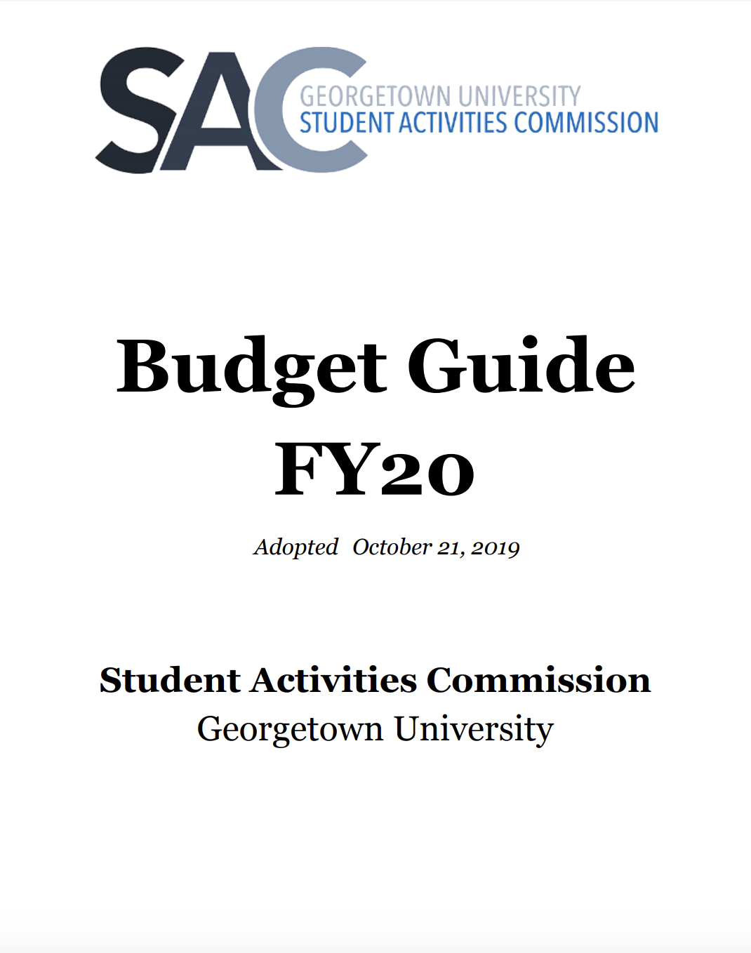
Addressing Concerns
Proposed Gaps in our system
  Using our $ to make unapproved purchases
  Attendance
The Relationship between SAC and the CSE
  Email timeline
Transparency
  Sent FinApp all of our internal records
Our Fiscal Responsibility
  The last time we had $250k
  Currently in a unique situation
  Constantly making improvements
How are we working to be better?

Slide 4



Reforms
IMPORTANT: We will NOT make value judgments
Timing of Future Leadership Transitions
Relationship with the CSE
Our New Audit Process
Increased Responsibility for NCD
Bystander Training

Slide 5
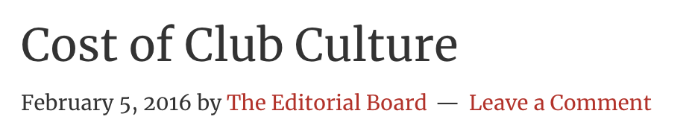

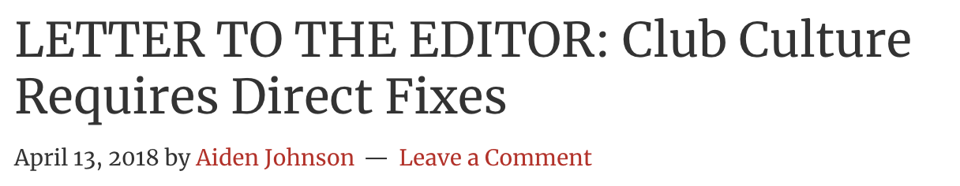
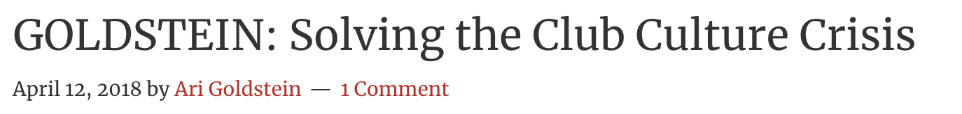


Slide 6
Why SAC Matters
123
Clubs that fall under SAC
1000+
Events in Fall 2019
4000
Active Members in SAC Organizations

Slide 7
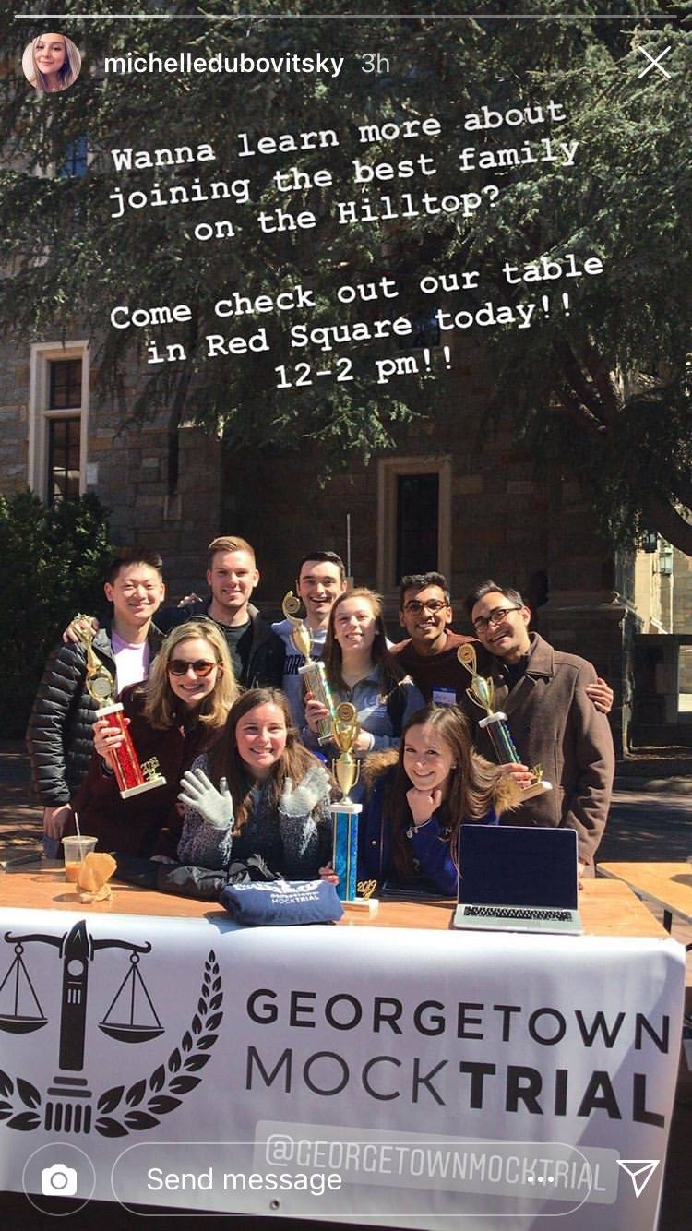
Alternate Proposals
Please See Our Appeals Submission

Slide 8
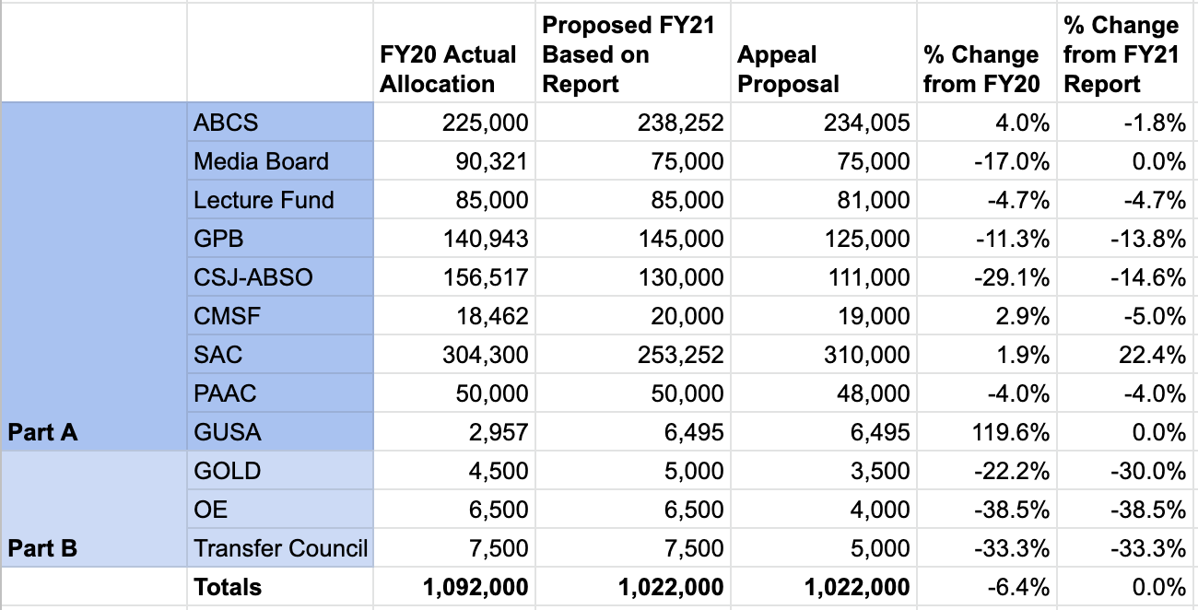
Proposal 1
Partial Part B Cut

Slide 9

Proposal 2
Partial Part B Cut, $10k SEF Cut

Slide 10
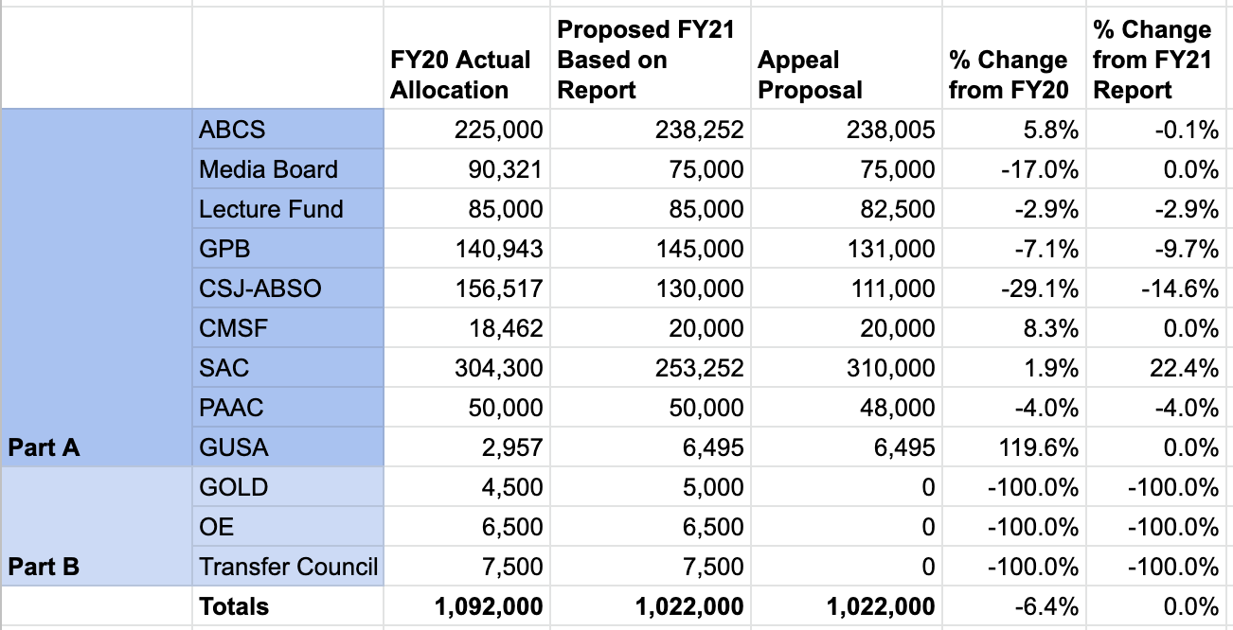
Proposal 3
Zero Part B

Slide 11
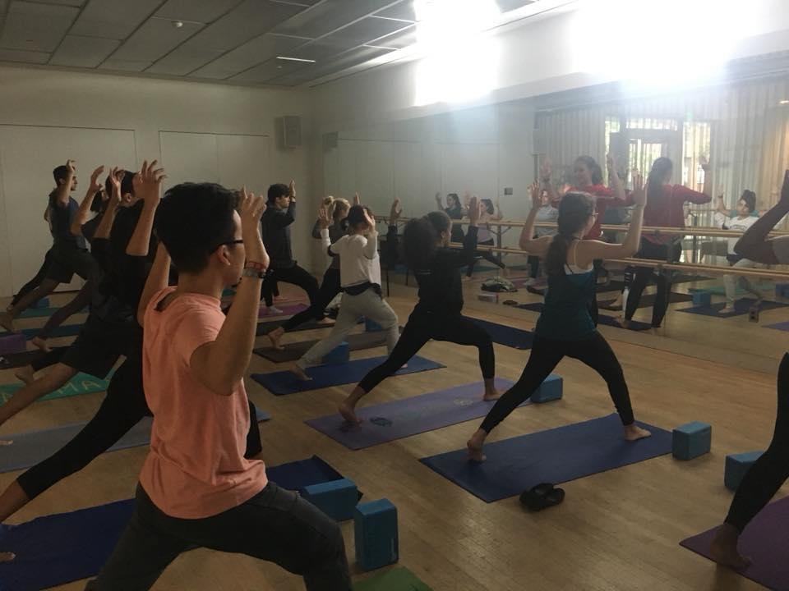
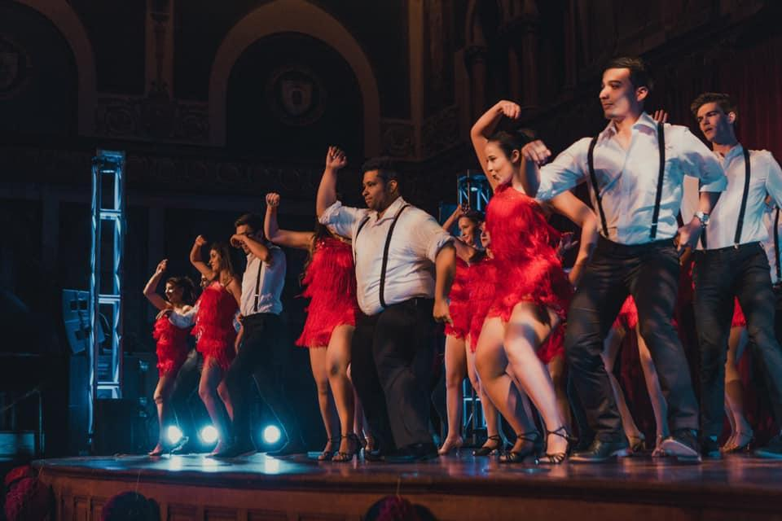
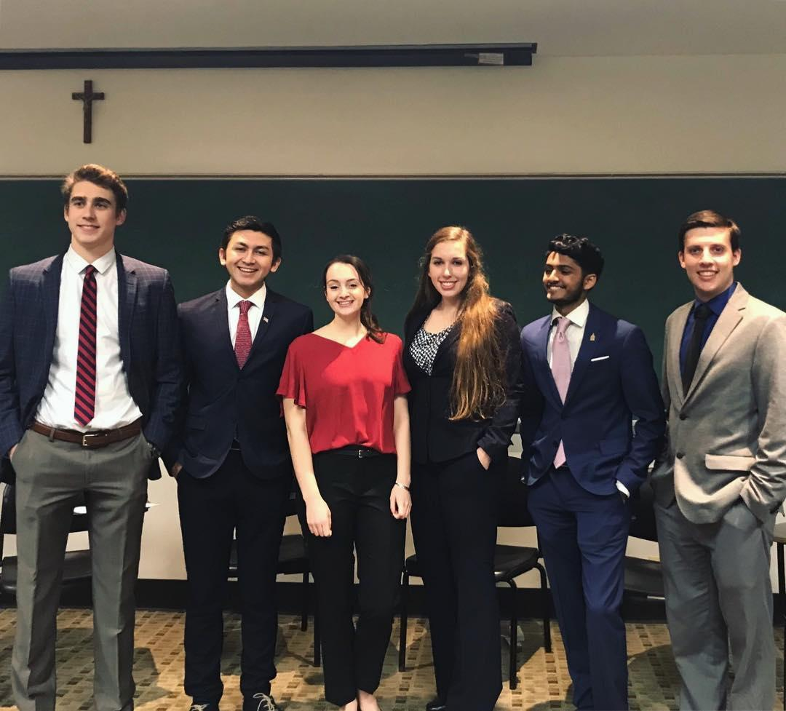
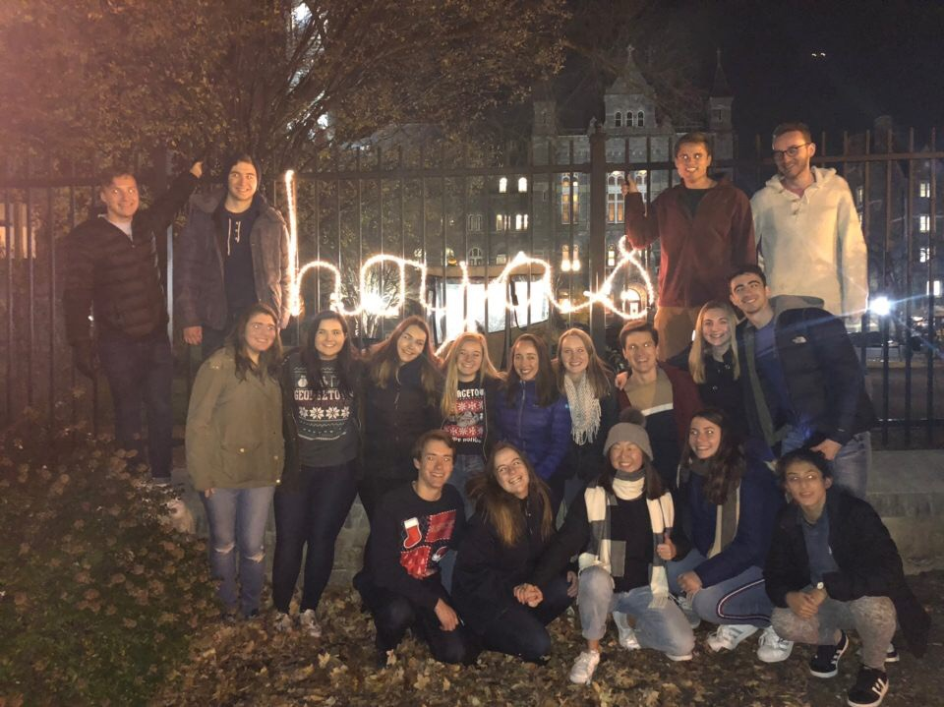
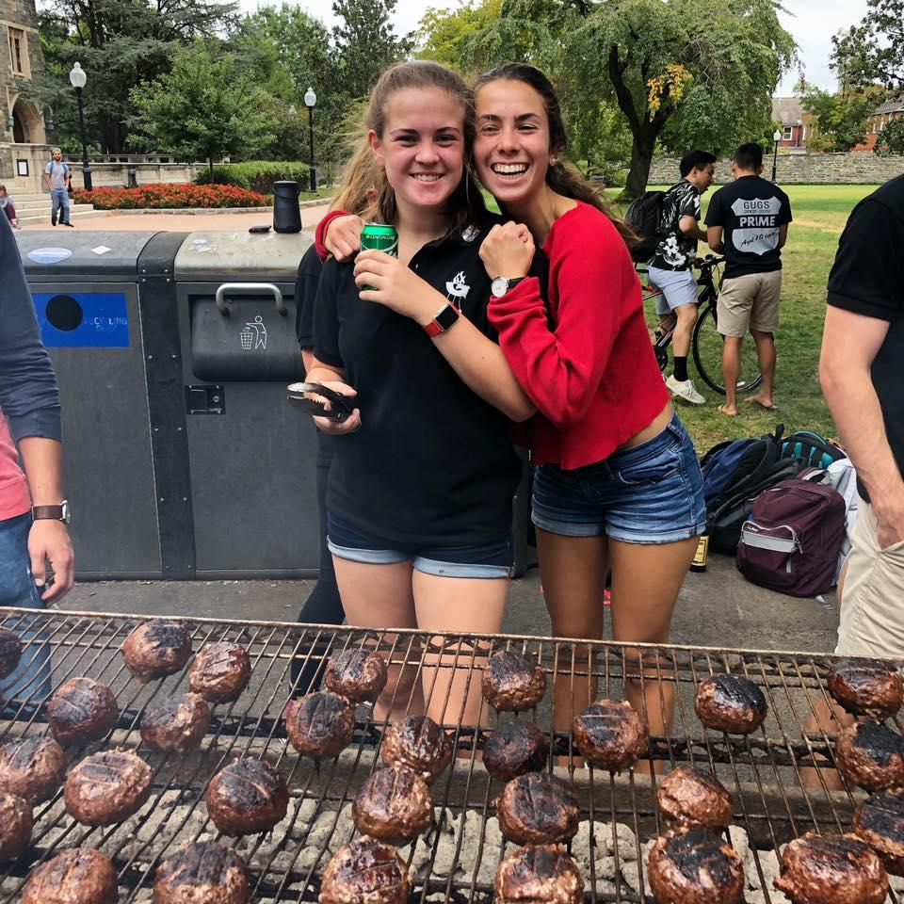
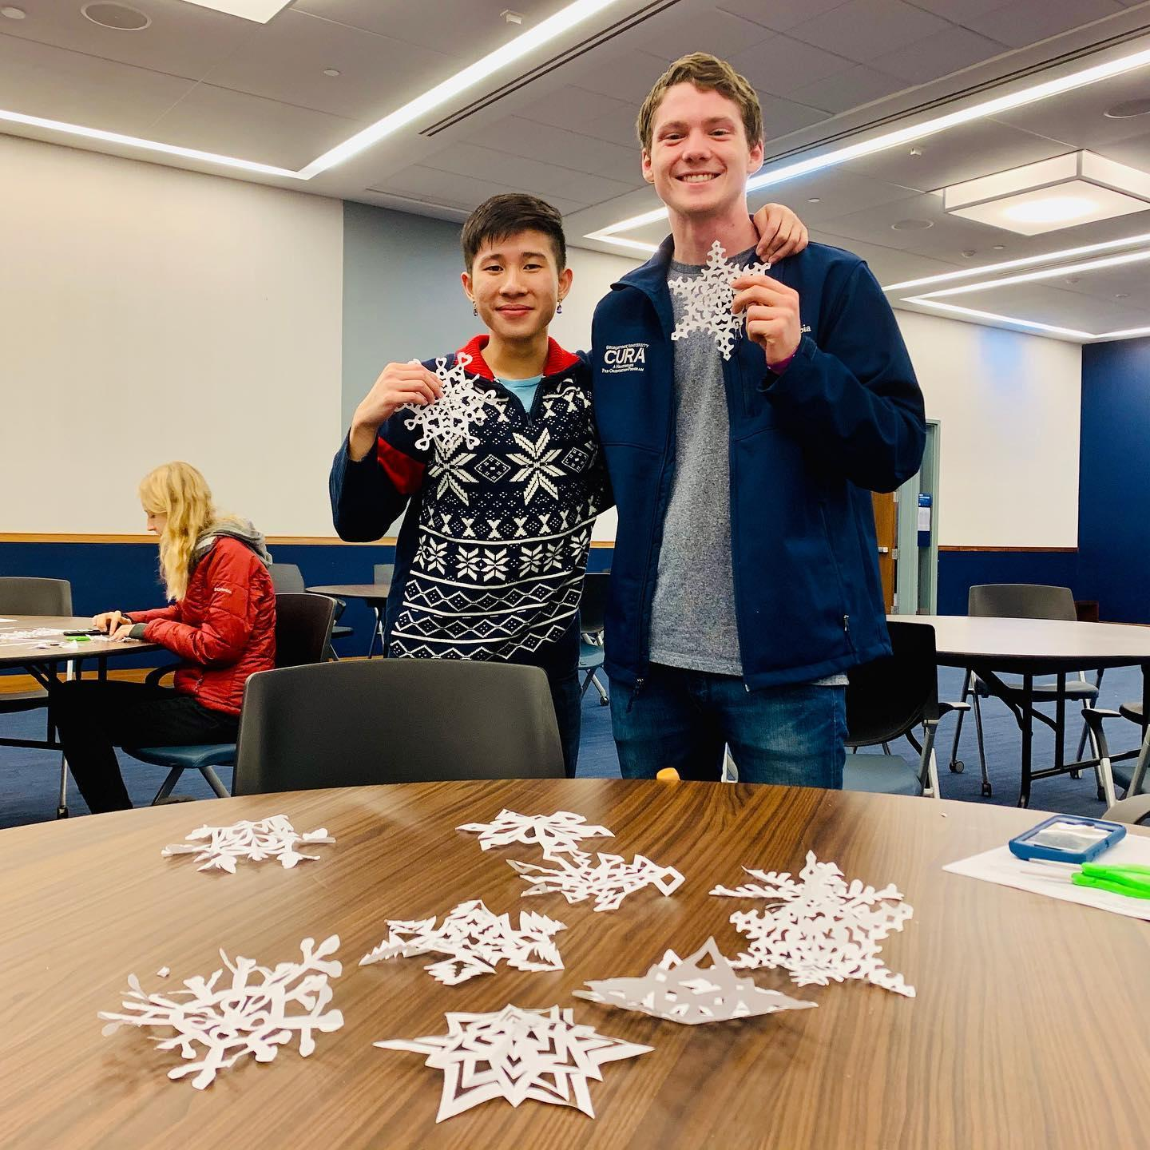
Hoya Saxa
Notes:
Speak

Slide 12
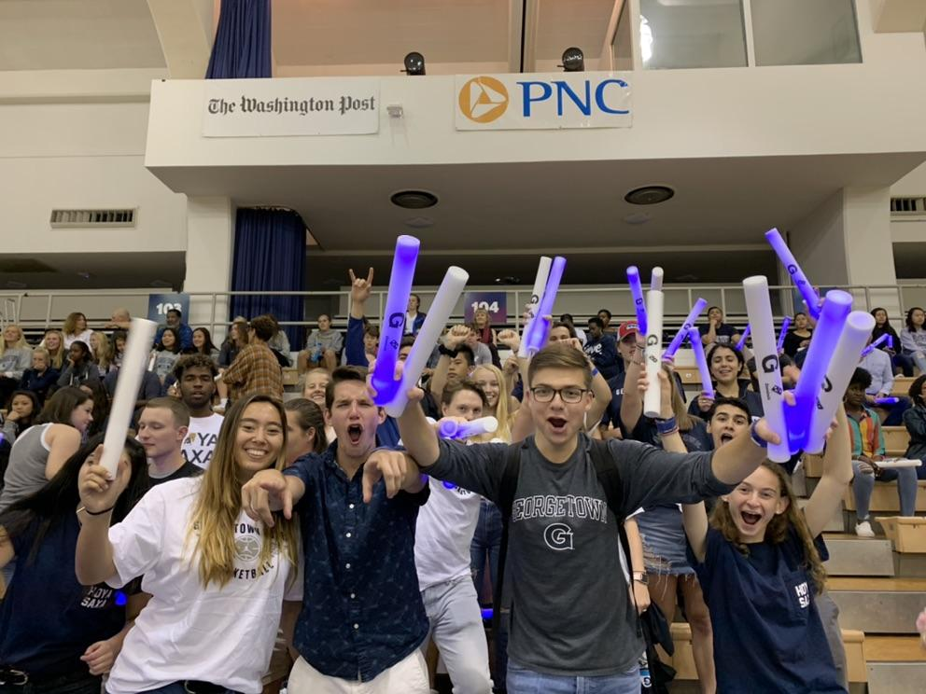
Thank You

